Slide 1
19 October 2021
Achieving political interest and success
Arlene Wilkie
Stroke Alliance for Europe

Slide 2
Stroke Alliance for Europe (SAFE)
Who are we
SAFE is a non-profit-making organisation formed in 2004 in Brussels, Belgium.
We are the voice of stroke survivors in Europe.
We represent stroke support organisations (SSOs) from more than 30 European countries.
Our vision
To work towards greatly decreasing the number of strokes in Europe and that all who are touched by stroke get the help and support they need.
Our aims
To reduce the numbers and the effects of strokes across Europe.
What we do
to the advancement of stroke prevention and the improvement of the quality of life of stroke survivors,
Help grow and develop stroke support organisation
Campaigning at a European level, and by supporting members to do so locally.
Encouraging research

Slide 3
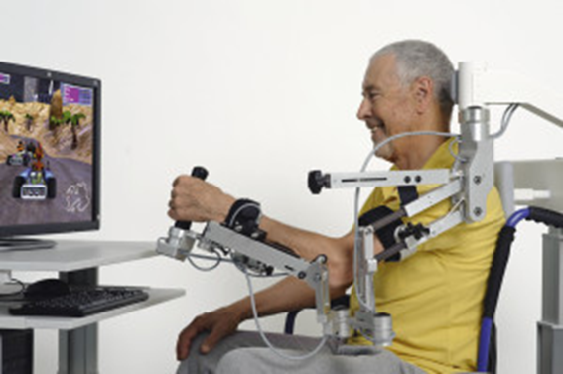
Why is the Stroke Action Plan for Europe important?
“Due to deficiency of post- stroke services, stroke survivors leave for psychiatric hospitals or institutions for mentally handicapped people”. Czech Republic
“There is no state certification/ accreditation of stroke units. As such we have no medical specialty «stroke medicine». Thus stroke patients are treated not by specially educated stroke physicians, but mainly by general neurologists”. Ukraine
“In therapy terms, patients effectively walk off a cliff after they pass through the hospital gates”. Ireland
“There is no structured, standardised care management for stroke- patients when they return home”. Germany
“The life after stroke is the poorest point of the care process”. Spain
“Thousands of stroke survivors do not receive the support they need with their recovery when they leave hospital”. UK
(Reference: SAFE interviews with members summer 2019)

Slide 4

Why is the Stroke Action Plan for Europe important?
Stroke is a leading cause of early death and disability
Increasing numbers of strokes and cost of stroke care
Disparities between & within countries along the entire stroke care pathway, with post-stroke support being neglected by all countries
Many countries do not have a specific and/or a comprehensive strategy for dealing with stroke, supported with adequate funding
The pandemic has only made this situation worse
THIS IS
EUROPE
Fuels the need for a Stroke Action Plan to confront stroke & its impact on our European citizens
References: Burden of Stroke: https://www.safestroke.eu/burden-of-stroke/
Economic impact of stroke: https://www.safestroke.eu/economic-impact-of-stroke/

Slide 5



Who is leading on this?
Stroke Action Plan Implementation committee
Chair: Professor Hanne Christensen
Co-Chair: Dr Francesca Romana Pezzella and Arlene Wilkie
Total 14 committee members from SAFE and ESO from across Europe
All work done far is here: https://actionplan.eso-stroke.org/

Slide 6
What do we hope to achieve?
What are we trying to achieve
Getting your Government to commit to implementing a national stroke plan, to funding stroke services and to audit those stroke services
How will this help?
highlight stroke services that are not meeting minimum standards
identify what needs to be done to bring about improvements in services
plan for the recruitment and training of the stroke specialist workforce needed
enable stroke support organisations to work with local health systems to promote public awareness campaigns on recognising stroke symptoms and reducing people’s risk of having a stroke; and to provide much needed life after stroke support
highlight issues between countries
Most important of all - lead to better outcomes – fewer people will die from their stroke, and more people will make a quicker and better recovery from the impact of their stroke

Slide 7
What have we been doing?
Stakeholder analysis
Form a working group/ committee
Be clear on what you want to change
Get your voice known!
Communicate and work with the Ministry of Health
What did we do?
Developing and supporting national coordinators in each county
Information meetings and advocacy training sessions in 2020/2021
  48 countries have coordinators in potential 52 countries
  89 people named coordinators

Slide 8
What have we been doing?
Declaration
1. A national stroke plan defining pathways, care and support after stroke including pre-hospital phase, hospital stay, discharge and transition, and follow-up.
2. At least one individual from the respective Stroke Support Organisation SSO (if existent) will be involved and supported, in an equal way, during the development of each country’s national stroke plan or stroke related guideline.
3. A national strategy for multi-sectorial public health interventions promoting and facilitating a healthy lifestyle and risk factor control has been implemented.
4. Establishment of national and regional level systems for assessing and accrediting stroke clinical services, providing peer support for quality improvement, and making audit data available to public.
5. All stroke units and other stroke services independent of sector undergo quality auditing continuously or with regular time intervals (% audited/certified).
6. Access to stroke unit care for patients with acute stroke (% admitted to stroke unit care <24 hours).
7. Recanalisation treatment rate provided for patients with ischaemic stroke (% receiving intravenous thrombolysis or mechanical thrombectomy calculated out of all ischaemic stroke admissions).
8. Access to: CT/MRI, vascular imaging, ECG, long-term ECG-monitoring, cardiac echo (TTE, TOE), dysphagia screening, and blood tests during stroke unit admission (% of stroke units with access).
9. Access to early stroke unit rehabilitation including early supported discharge (% access).
10. Access to basic secondary prevention including antithrombotics, antihypertensives and statins as well as life style advice (% according to WHO data).
11. A binding personalised, documented rehabilitation and sector transition plan provided at the time of discharge (% patients provided with plan).
12. Follow-up at 3-6 months after the stroke incident including a Post Stroke Check list and a functional assessment and referral for relevant interventions (% patients with follow-up)

Slide 9









Success!
https://actionplan.eso-stroke.org/the-declaration-for-action-on-stroke/
Launch on European Stroke Awareness Day
Declaration has been translated in 17 languages
Signed! Progressing towards
signing!

Slide 10
Still more to do!
https://actionplan.eso-stroke.org/
THANK YOU FOR LISTENING
arlene.wilkie@safestroke.eu
Twitter @StrokeEurope
Facebook @safestroke
#StrokeStillMatters

