Slide 1
Stroke Service Tracker
Hanne Christensen
SAP-E Webinar 19 10 2021

Slide 2
Why is a Stroke Service Tracker needed?
Domain: Evaluation of Outcomes and Quality improvement
The Stroke Service Tracker is useful to:
  To guide decisions
    Identify weaknesses
    Identify strengths
  To support arguments for change
    Enabling comparisons over time and between countries
A Stroke Service Tracker provides a continuous mapping of the status in Europe

Slide 3
Does Stroke Service Tracking improve Stroke Care?
Development i Denmark after implementation of a SST program
Based on data from Danish Stroke Registry RKKP.dk

Slide 4
SAP-E Prerequisites for an efficient and feasible model
Ensuring minimal workload for National Coordinators
Avoiding GDPR issues
Fit with different systems of healthcare
Fit with countries’ actual challenges – one size does not fit all

Slide 5
Data
Only aggregate summary data are collected (eg total number of people with stroke)
Basic data – for example:
  number of people with strokes
  Number of stroke units
Key performance indicators
  The 12 KPIs

Slide 6
Data sources
Availability of data sources will vary – and thereby quality of data
  Used data sources are declared
  Estimates are made when no data is available
  Documentation for e.g. a National Stroke plan (KPI 1) is uploaded

Slide 7
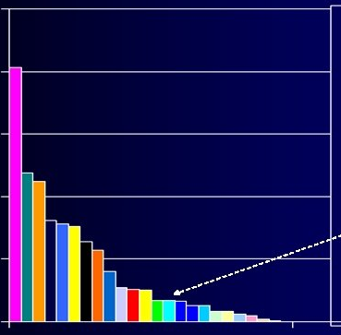
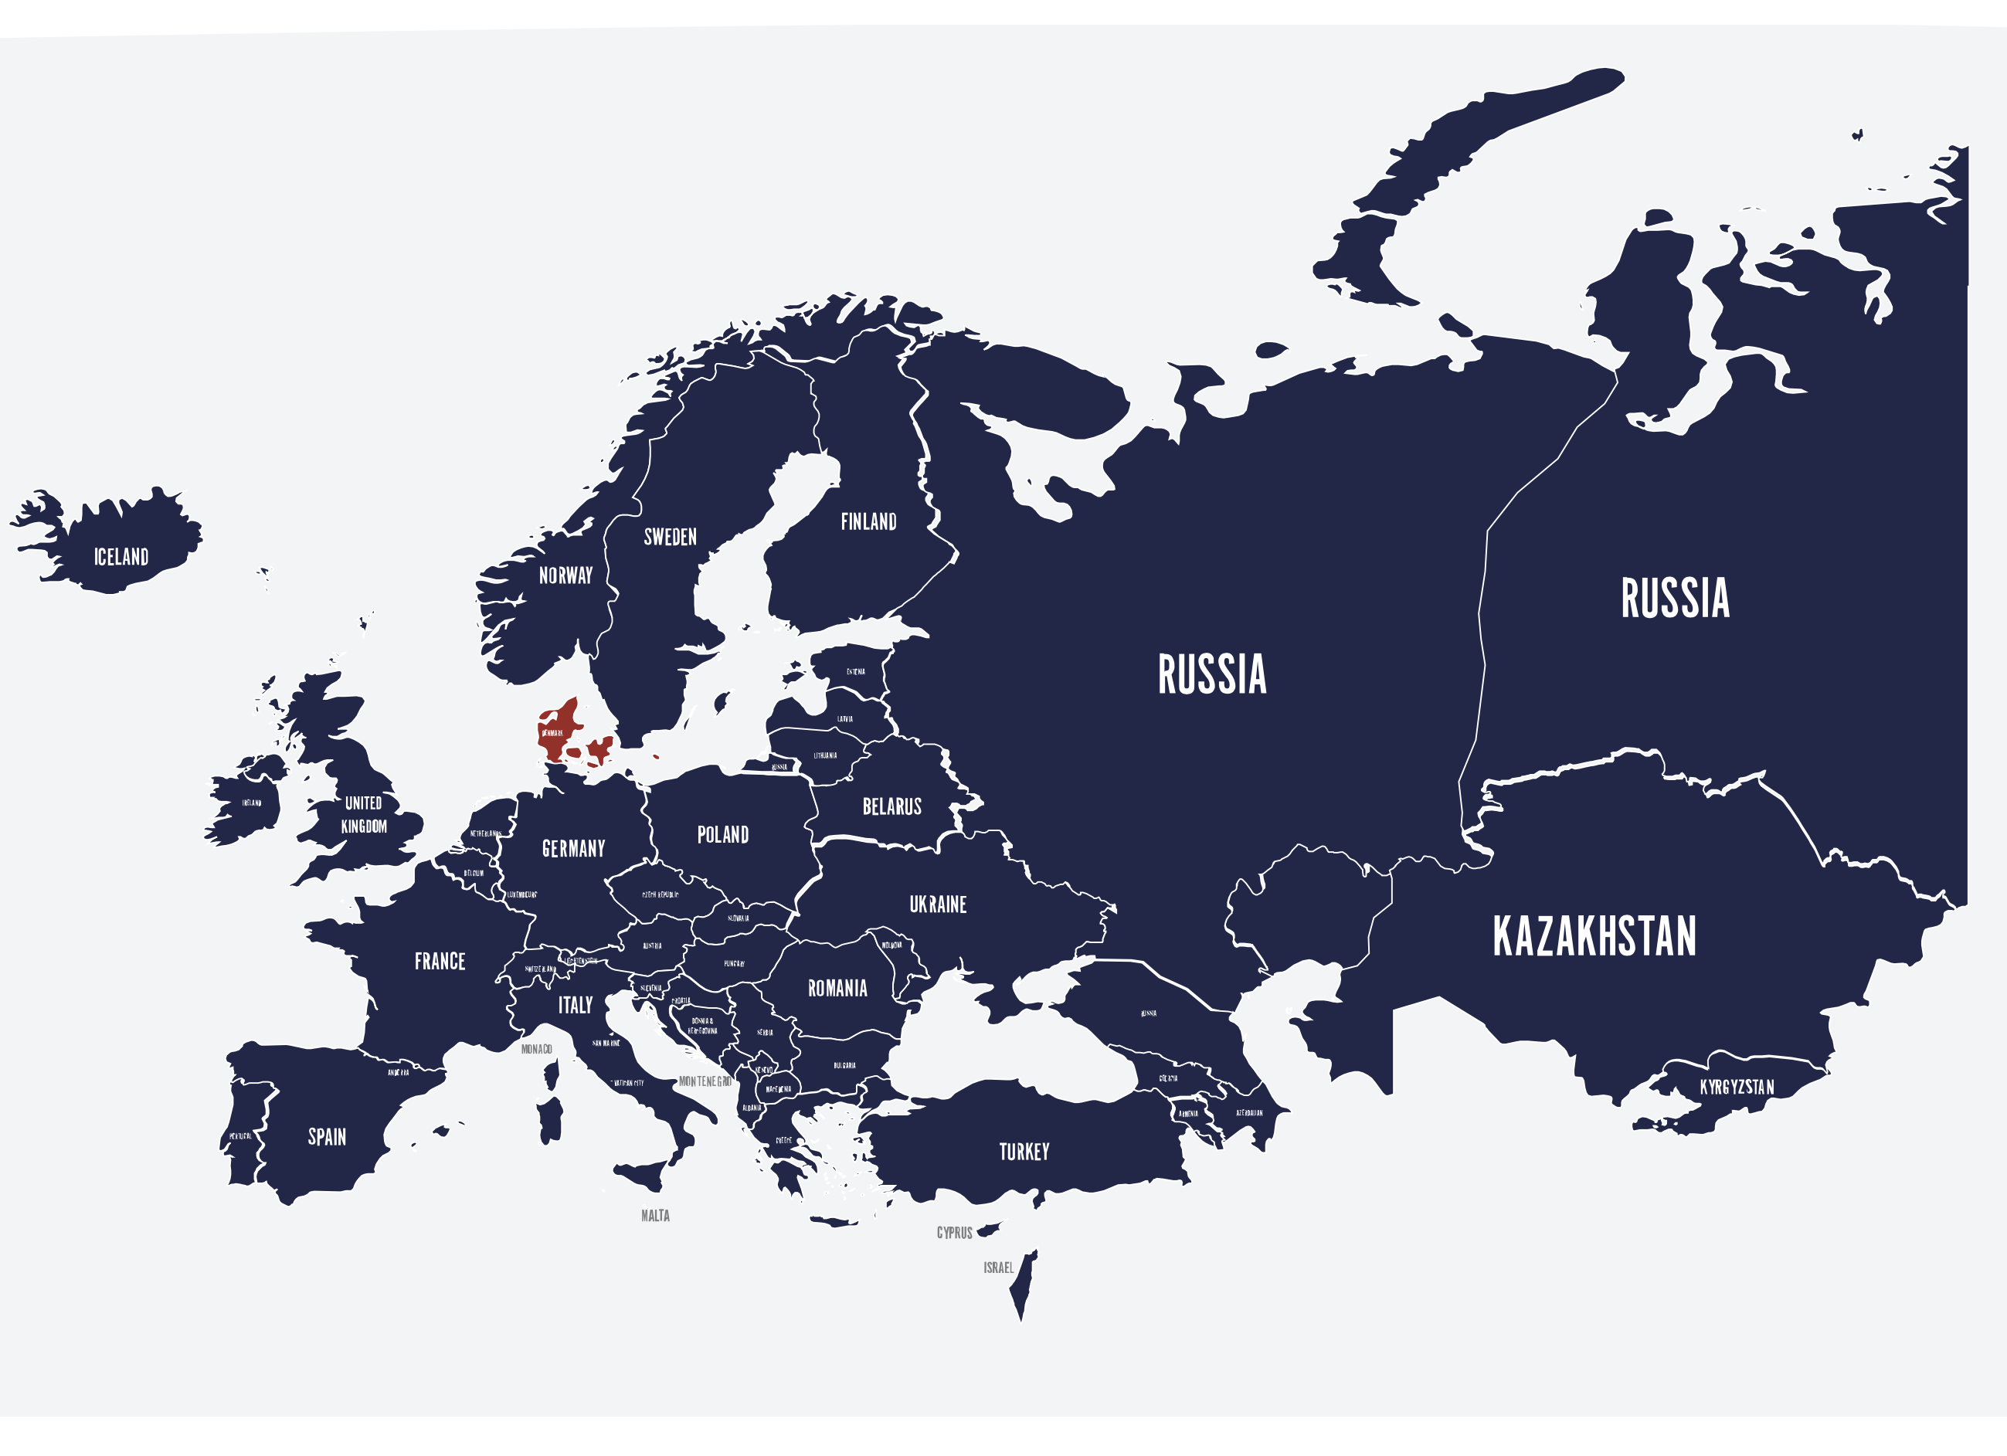
How is data presented?
Main results including KPIs will be presented at SAP-E website and a paper report will also be issued
Comparisons: column diagrams ordered by value and colouring of a map
Data for countries will be found by clicking on a country

Slide 8
How is data uploaded?
Annual upload
Service Tracker Data
  Link provided for NC, activity is logged
  When data is available we estimate that uploading time will be 60 – 90 minutes.
Auditing and Benchmarking at country level: annual
  Data for last year to be reviewed
  Benchmarking at country level is set annually at a realistic level and revised annually

Slide 9
Status
System in beta-test – we’re grateful to Estonia (Janika Korv) and Greece (Giorgos Tsivgoulis) and their teams ☺
First circulation for 2020 data: end 2021
From 2022 data to uploaded after first quarter (last year’s data will usually be available at this time)

