Slide 1
The SAP-E VISION
Valeria Caso, MD, PhD
Stroke Unit, Perugia
Italy

Slide 2


Disclosures
Stocks
None
Drug trials (< 5 years)
SOCRATES
BRAINSGATE
NAVIGATE ESUS
THALES
PACIFIC STROKE/AF
Advisory boards & speaker fees (< 3 years)
Boeringher-Ingelheim
Pfizer/BMS
Bayer
Mindmaze
Daiichi Sankyo
Ever-NeuroPharma
Notes:
2

Slide 3

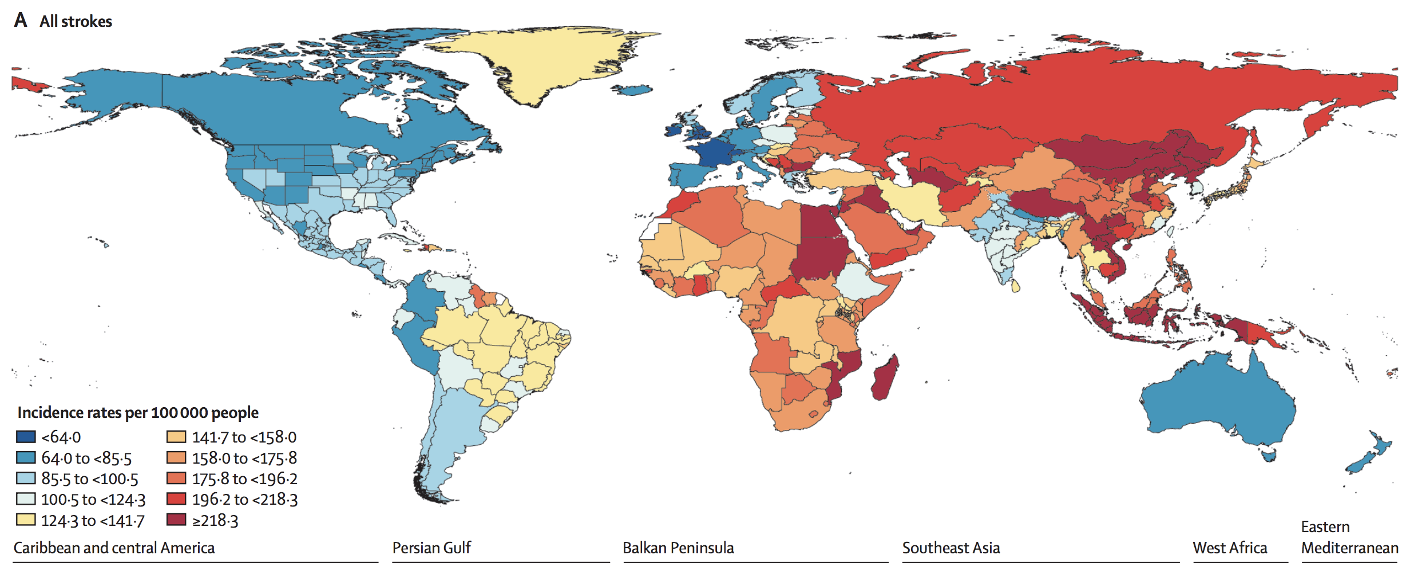

Slide 4
The European Stroke Action Plan 2018 to 2030 –
”the 3rd Helsingborg declaration”
The seven domains of the Action Plan
Primary Prevention (new)
Organization of Stroke Services
Management of Acute Stroke
Secondary prevention and organized follow-up
Rehabilitation
Evaluation of Stroke Outcome and Quality Assessment
Life after stroke (new)
A basic principle:
The Action Plan is
free from involvement
from industry
A separate group on
Prioritized Research Areas for translational stroke research.

Slide 5
Overarching targets for 2030
- to reduce the absolute number of strokes in Europe by 10 %
- to treat 90 % or more of all patients with stroke in Europe in a dedicated stroke unit as the first level of care
- to have national plans for stroke encompassing the entire chain of care from primary prevention to life after stroke.
- to fully implement national strategies for multisector public health interventions to
promote and facilitate a healthy lifestyle, and reduce environmental (including air pollution),
socioeconomic and educational factors that increase the risk of stroke.

Slide 6
1. Primary Prevention targets
- achieving universal access in Europe to primary preventive treatments based on
improved and more-personalized risk prediction.
- full implementation of national strategies for multisectorial public health interventions
promoting and facilitating a healthy life-style, and reducing environmental,
socioeconomic and educational factors that increase the risk of stroke.
- making available evidence-based screening and treatment programmes for stroke risk
factors in all European countries.
- having blood pressure detected and controlled in 80% of persons with hypertension.

Slide 7
2. Organization of Stroke Services targets
- establishing a medical society and stroke support organization in each country, which
collaborates closely with the responsible body in developing, implementing and
auditing the national stroke plan.
- guiding national stroke care by evidence-based pathways that cover the entire chain of care.
These pathways are understood by the public, and may be adapted to meet regional
circumstances to ensure equal access to stroke care irrespective of patient characteristics,
region, and time of hospitalization.
- managing and delivering stroke care by competent personnel and teams,
and creating plans for effective recruitment and training as part of a national stroke plan.
- all stroke units and other stroke services undergo regular certifications or equivalent
auditing processes for quality improvement.

Slide 8
3. Management of Acute Stroke targets
- Treating 90 % or more of all patients with stroke in Europe in a stroke unit as the first level of care.
- Guaranteeing access to recanalization therapies to 95% of eligible patients across Europe.
- Decreasing median onset-to-needle times to <120 minutes for intravenous thrombolysis and
onset-to-reperfusion times to <200 minutes for endovascular treatment.
- Achieving IVT rates above 15%, and EVT rates above 5%, in all European countries
- Decreasing first-month case-fatality rates to <25% for ICH and SAH, and increasing the rate
of good clinical outcomes to >50%.

Slide 9
4. Secondary prevention targets
- including secondary prevention in national stroke plans with follow-up in primary/community care
- ensuring that 90% of the stroke population should be seen by a stroke specialist and have access
to secondary prevention management (investigation and treatment)
- ensure access to key investigational modalities: CT (or MR) scanning, carotid ultrasound, ECG,
24-hour ECG, echocardiography (transthoracic and transoesophageal), blood tests
(lipids, glucose, HbA_{1c}, coagulation, erythrocyte sedimentation rate, C-reactive protein,
autoantibodies)
- ensuring access to key preventative strategies: lifestyle advice, antihypertensives, lipid
lowering agents, antiplatelets, anticoagulants, oral hypoglycaemic agents and insulin,
carotid endarterectomy, and PFO closure.

Slide 10
5. Rehabilitation targets
- guaranteeing that at least 90% of the population have access to early rehabilitation within the stroke unit
- providing early supported discharge to at least 20% of stroke survivors in all countries
- offering physical fitness programmes to all stroke survivors living in the community
- providing a documented plan for community rehabilitation and self-management support
for all stroke patients with residual difficulties on discharge from hospital
- ensuring that all stroke patients and carers have a review of the rehabilitation and other
needs at 3‒6 months after stroke and annually thereafter.

Slide 11
6. Evaluation of outcomes & quality improvement targets
- defining a Common European Framework of Reference for Stroke Care Quality that includes:
a) development or update of European guidelines for management of acute stroke care,
b) definition of a common dataset covering core measures of stroke care quality to enable
accurate international comparisons of care both in hospital and in the community (including
structure, process, outcome measures, and patient experience)
- assigning a named individual who is responsible for stroke quality improvement in each
country or region
- establishing national and regional level systems for assessing and accrediting stroke
clinical services, providing peer support for quality improvement, and making audit data
routinely available to the general public
- collecting patient-reported outcomes and longer-term outcomes (e.g. 6 months and 1 year),
covering both hospital and community care.

Slide 12
7. Life After Stroke targets
- appointing government level individuals or teams responsible for championing life
after stroke and ensuring that national stroke plans address survivors’ and their
families’ long-term unmet needs. Minimum standards set for what every stroke survivor
should receive regardless of where they live.
- formalizing the involvement of stroke survivors and carers, and their associations, in
identifying issues and solutions to enable the development of best patient and support practices
- establishing, through national stroke care plans, the support that will be provided to stroke
survivors, regardless of their place of residence and socioeconomic status
- supporting self-management and peer support for stroke survivors and their families, by
backing stroke support organizations
- supporting the implementation of digitally-based stroke self-help information
and assistance systems.

Slide 13
Prioritized research areas for translational stroke research
- achieving an organizational framework by implementing confirmatory preclinical
research through ‘team science’ and by providing novel instruments for
advanced experimental designs to increase validity
- establishing and implement guidelines for preclinical trials of new treatments
to maximize the success of clinical translation
- focusing experimental stroke research on identification of new treatable targets
with high translational potential that lead to successful clinical trials by 2030.

Slide 14
Implementing the European Stroke Action Plan: proposed time lines
Review
of targets
and R&D
Mid-term
review
Review
of targets
and R&D
Final review
(SDG final year)
2018
2021
2024
2027
2030

Slide 15



























ESO Associated National Stroke Societies
Swiss Stroke Society
Swiss Heart Foundation
Fragile Suisse
Österreichische Schlaganfall Gesellschaft
Société Française Neuro-Casculaire (SFNV)
Deutsche Schlaganfallgesellschaft (DSG)
Dutch Society of Neurology
Norwegian Stroke Organisation (NSO)
Romanian National Stroke Association
Belgian Stroke Council
Czech Stroke Society
Hungarian Stroke Society
Latvian Stroke Society
Ukrainian Anti-Stroke Association
Polish Neurological Society
Slovak Neurological Stroke Association
Irish Heart Foundation
Lithuanian Stroke Society
Swedish Acute Neurology Society (ANS)
Soc. Portuguesa do Acidente Vascular Cerebral
Bulgarian Society of Neurology
Danish Stroke Society
Catalan Society of Neurology
Spanish Society of Neurology (SEN)-GEECV
Croatian Society for Neuro-
vascular Disorders
Croatian Stroke Society
Turkish Cerebrovascular Diseases Society
Finnish Brain Association
Finnish Neurological Society
Italian Stroke Organisation
Società Italiana per lo studio dello stroke (SISS)
A.l.i.Ce Italia
Hellenic Stroke Organisation
Hellenic (Greek) Society of Cerebrovascular Diseases
British Association of Stroke Physicians (BASP)
Stroke Association

Slide 16
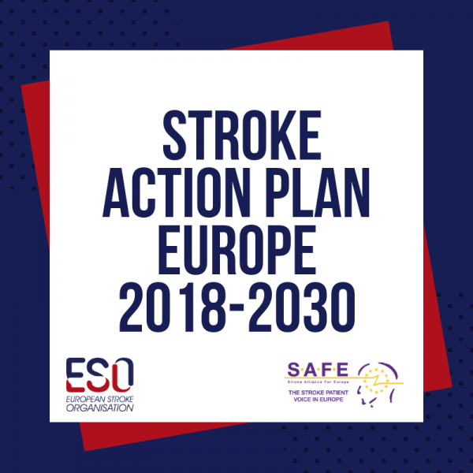
Visit us at https://actionplan.eso-stroke.org/

